Slide 1
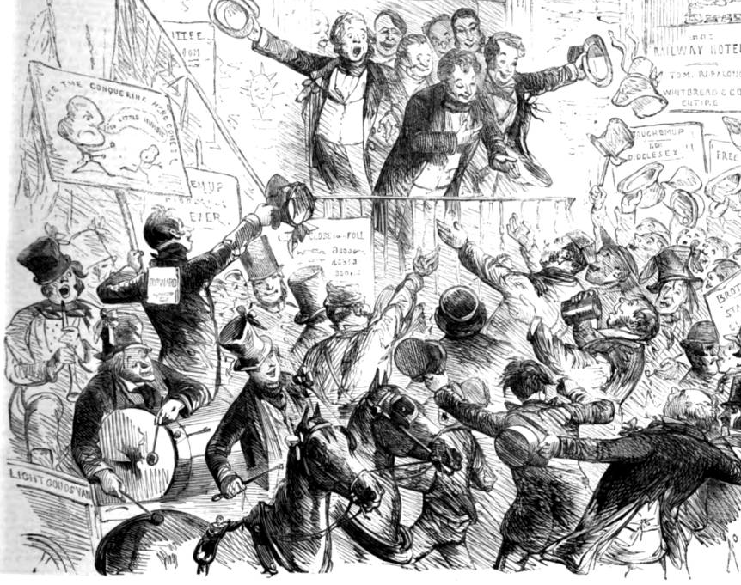

Get Out and Vote! The 1868 North Durham Election
In collaboration with

Slide 2
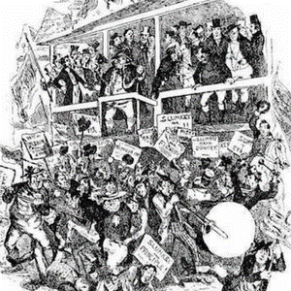
Lesson Plan
National Context
Second Reform Act (1867)
General Election (1868)
The 1868 North Durham Election
Constituency characteristics
Candidates
Introduction to “Get Out and Vote”
Groups and tasks
Preparations

Slide 3
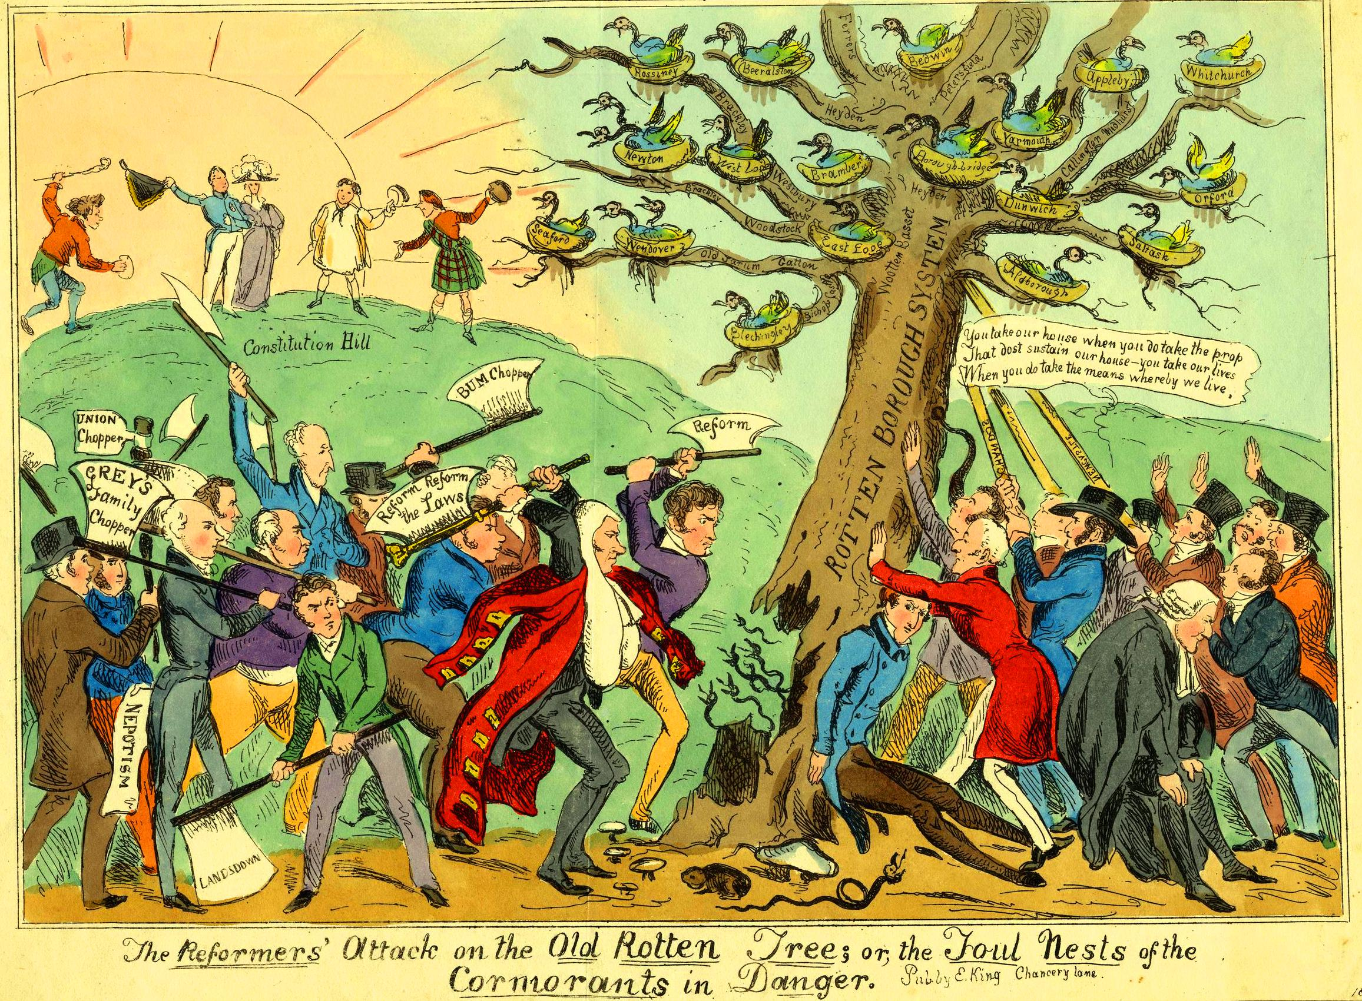
The Run-Up to the Second Reform Act (1867)
1832: Great Reform Act
Unified male franchise (1 in 7)
Elimination of “rotten boroughs”

Slide 4
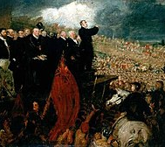
The Run-Up to the Second Reform Act (1867)
1832: Great Reform Act
Unified male franchise (1 in 7)
Elimination of “rotten boroughs”
1838-1857 Chartist Movement

Slide 5
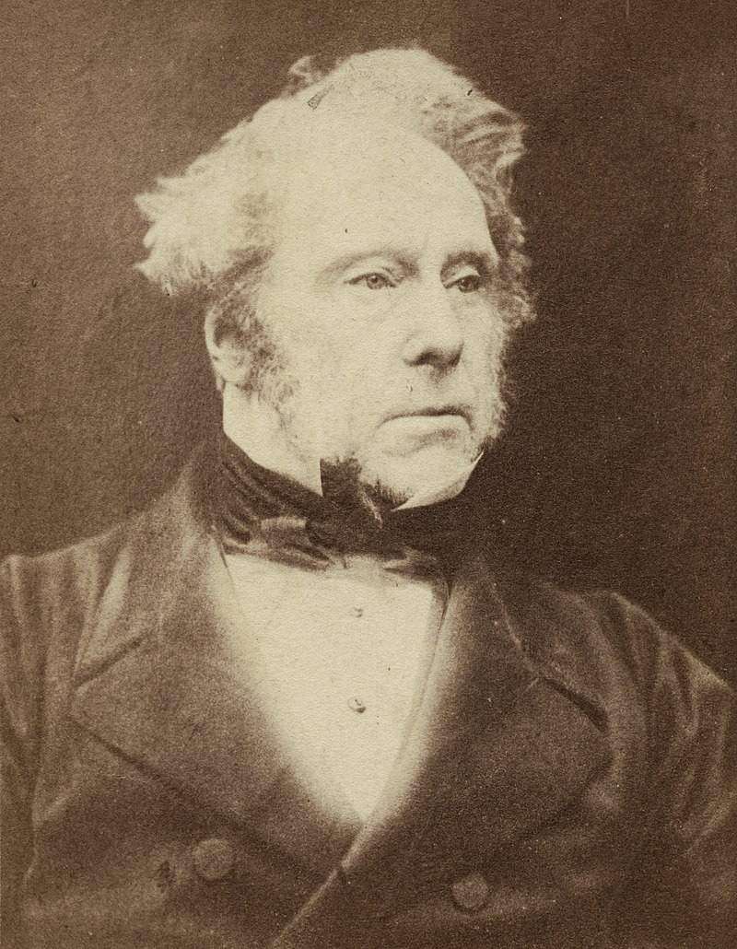
The Run-Up to the Second Reform Act (1867)
1832: Great Reform Act
Unified male franchise (1 in 7)
Elimination of “rotten boroughs”
1838-1857 Chartist Movement
1865 Death of Lord Palmerston, an opponent of franchise extension
Fresh demands for electoral reform

Slide 6
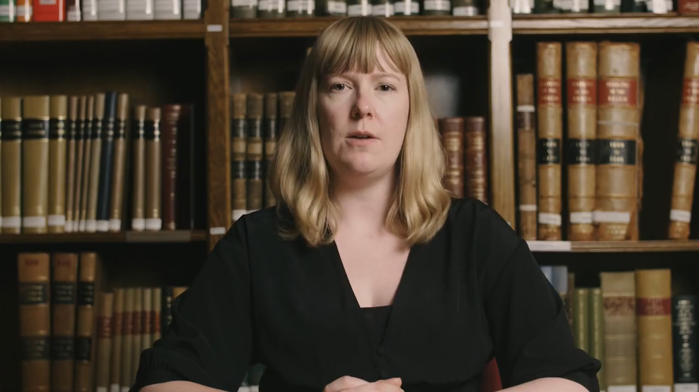
The Second Reform Act (1867)

Slide 7
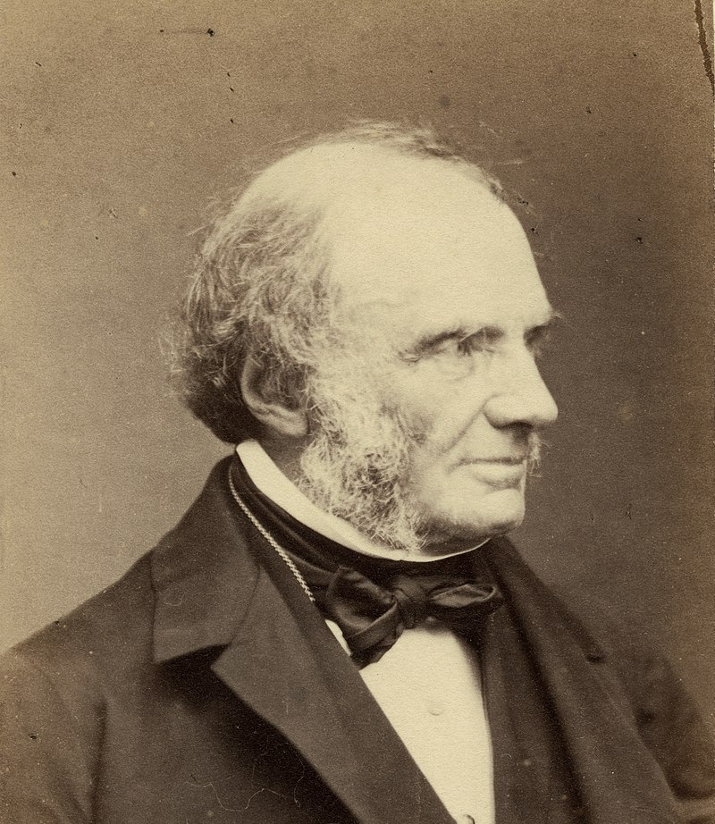
A Quick Recap
1866 Lord Russell introduced reform bill but failed to receive majority support and resigned

Slide 8
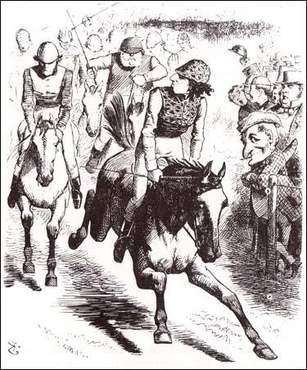
A Quick Recap
1866 Lord Russell introduced reform bill but failed to receive majority support and resigned
1867 the Conservatives under Lord Derby and Disraeli introduced their own reform bill
Economic crisis and call for reforms
Tactical decision to gain public support
Second Reform Act:
Boroughs: All householders and renters (>£10 a year)
Counties: Landowners and tenants with small plots of land
Nearly 3 in 7 men could vote

Slide 9
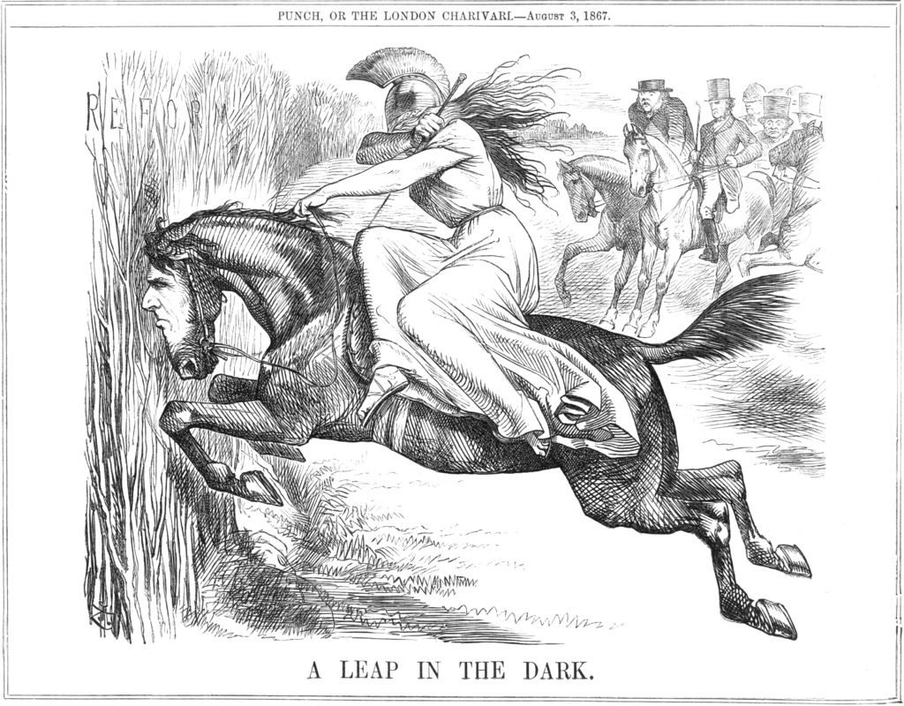
The 1868 General Election
Hoping to capitalise on the reform, Disraeli calls an election in November/December 1868
Last conservative electoral victory: 1852
Since 1857 Liberals under Palmerston held parliamentary majority

Slide 10
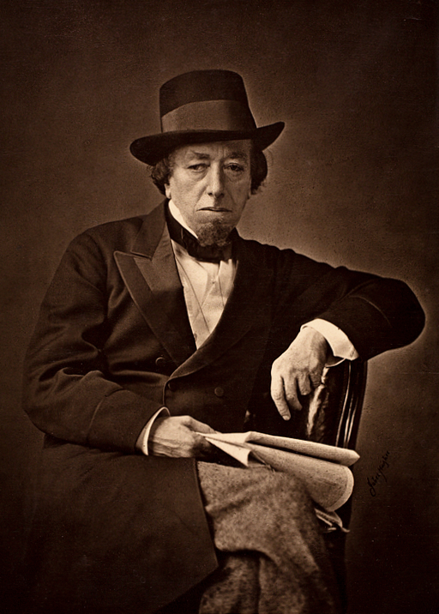
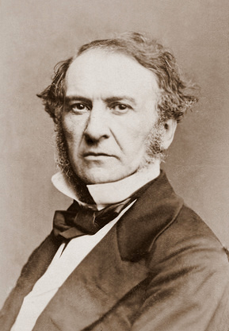
The 1868 General Election
Hoping to capitalise on the reform, Disraeli calls an election in November/December 1868
Last conservative electoral victory: 1852
Since 1857 Liberals under Palmerston held parliamentary majority
Both parties with new leaders: Disraeli v. Gladstone

Slide 11
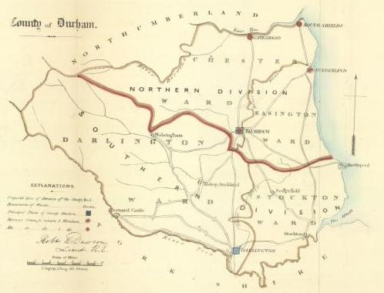
The North Durham Constituency
County constituency; much larger than today, covering everything north of Durham to the Tyne and from the sea to the Pennines.
Main occupations: farming and mining
Created in 1832; 2-member constituency
From 1837-1864 split Liberal/Conservative representation, since 1864/1865 two Liberal MPs
Liberal incumbents:
Robert Duncombe Shafto (1847-1868)
Sir Hedworth Williamson (since 1864)
10,576 voters (nearly double the number in 1865)

Slide 12
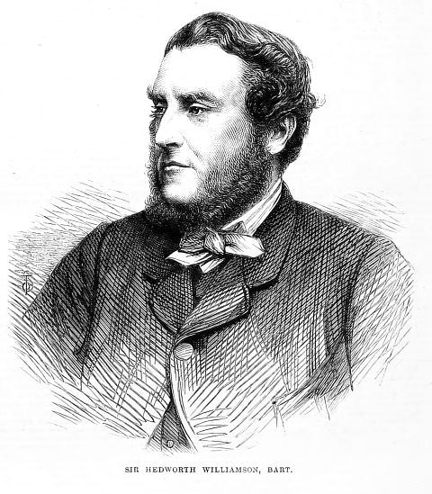
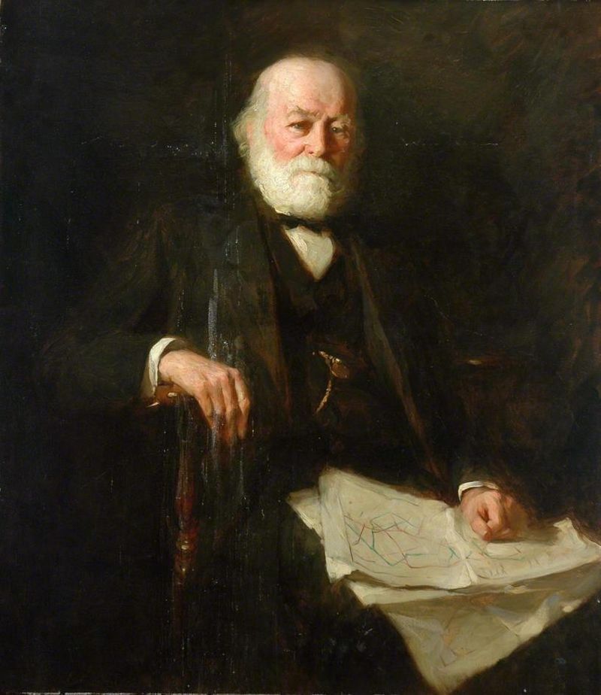
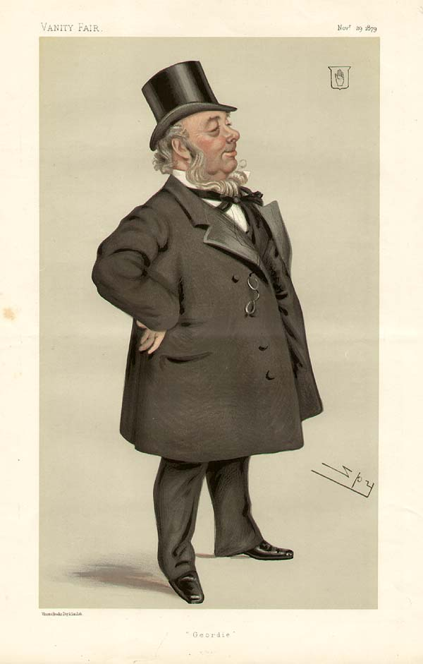
1868 Candidates for North Durham
Sir Hedworth Williamson (Liberal)
Mr. Issac Lowthian Bell (Liberal)
Mr. George Elliot (Conservative)

Slide 13
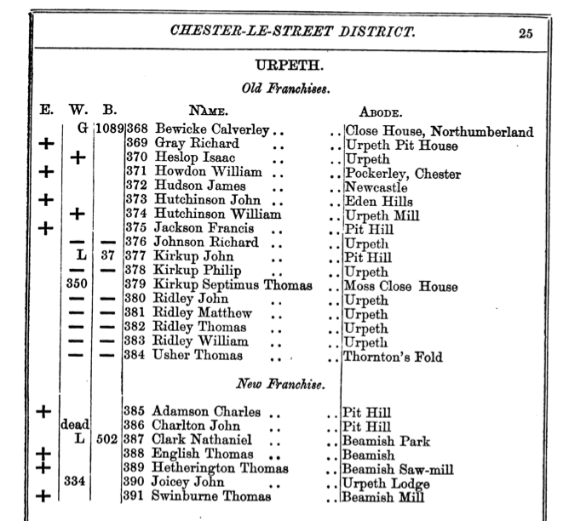
19th-Century Voting System
Each voter had up to 2 votes that he could allocate across the three candidates as follows:
Plump: Cast only one vote for his favorite candidate and forgo his second vote
Split-vote: Cast one vote for one candidate of one and the second vote for a candidate of the other party
Double partisan vote: Cast one vote for each of the two candidates of a party
Voters cannot cast more than one vote for a candidate.

Slide 14
“Get Out and Vote!” – Final Reminders
Date, Time, Meeting place for the trip to Beamish
Don’t forget:
Wear comfortable walking shoes
Wear weather appropriate outdoor clothes
Lunch

