Slide 1
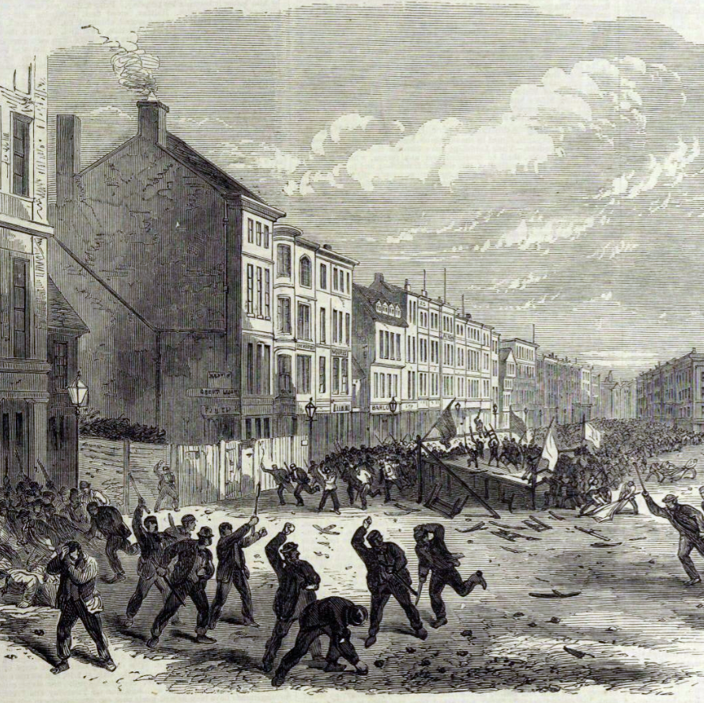

Understanding Democracy through 19th Century Elections
In collaboration with

Slide 2
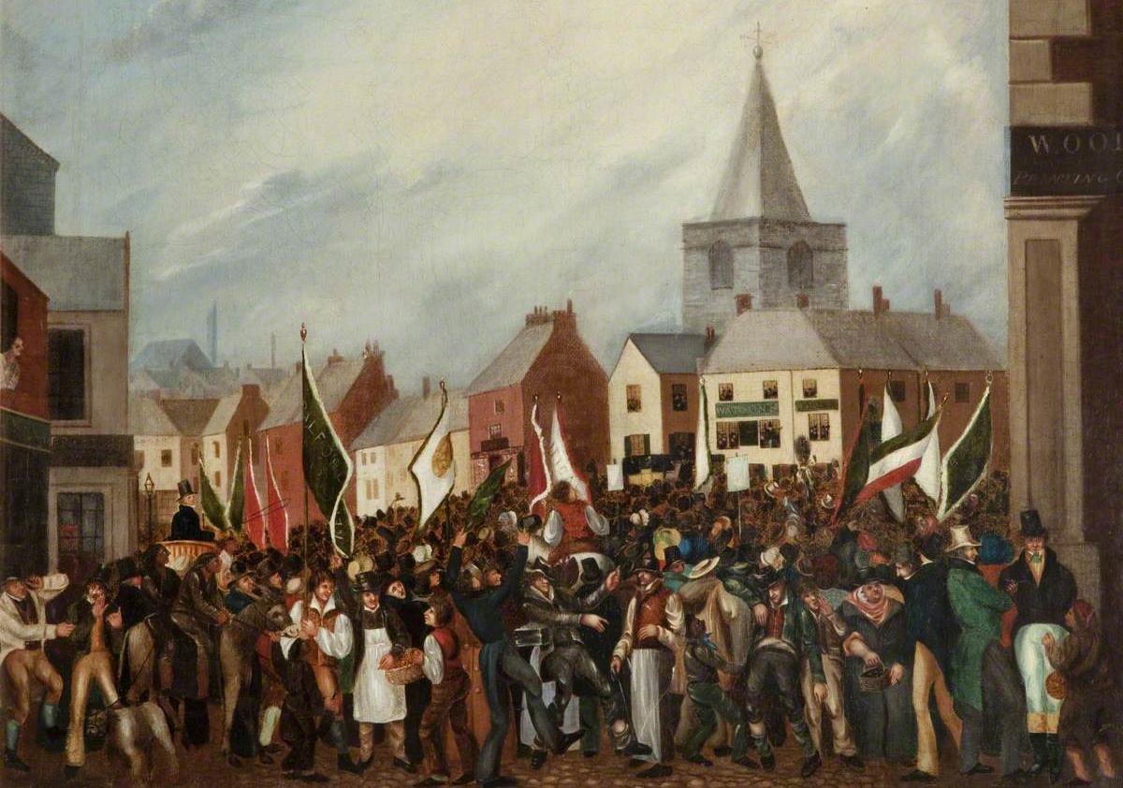
What can you see in this picture? What do you think might be happening?
Notes:
The 1832 Blackburn Election unknown artist Blackburn Museum and Art Gallery
https://artuk.org/discover/curations/elections-and-electioneering-1832-1868/template/showcase/slide-page/4/slide-page/3

Slide 3
The Picture actually shows what an election day looked like in the Nineteenth Century
Why might there be a crowd?
How does this scene compare to an election held today?
What might the flags represent?
The 1832 Blackburn Election, by an unknown artist
Blackburn Museum and Art Gallery
This was the first time Blackburn (Lancashire) had been able to elect an MP.
Notes:
The 1832 Blackburn Election unknown artist Blackburn Museum and Art Gallery
https://artuk.org/discover/curations/elections-and-electioneering-1832-1868/template/showcase/slide-page/4/slide-page/3

Slide 4
What were elections like in the Nineteenth Century?
Elections were public events.
Large crowds, most of whom were not able to vote, gathered to watch & take part in the spectacle.
Voting was conducted in public.
Each voter had to vote in full view of the large crowds.
The crowd wore colours to show who they were supporting.
Things often got violent. At this election one of the candidates took a large stone onto the stage with him. This stone had been thrown through his bedroom window that morning.
By this election in 1832 the franchise (which means those allowed to vote) had just been extended.
But this only allowed 1 in 7 men to vote. By 1868 1 in 3 men could vote
Elections often involved drunkenness.
Candidates often provided free drinks to their supporters.
The 1832 Blackburn Election, by an unknown artist
Blackburn Museum and Art Gallery
This was the first time Blackburn (Lancashire) had been able to elect an MP.
Notes:
The 1832 Blackburn Election unknown artist Blackburn Museum and Art Gallery
https://artuk.org/discover/curations/elections-and-electioneering-1832-1868/template/showcase/slide-page/4/slide-page/3

Slide 5
Lesson 1 – An introduction to democracy and elections in the Nineteenth Century
In this lesson you will:
Learn and understand the key terms, such as democracy, that you need for these lessons.
Discover what elections were like in the Nineteenth Century.

Slide 6
Democracy is today one of Britain’s fundamental values. Democracy means a system of government in which the people choose their rulers by voting for them in elections, whilst also limiting the power of those elected and protecting the rights of individual people. This means that in Britain we are a liberal representative democracy. These lesson will help you to discover how democracy developed in Britain during the 19th Century..
Did you know?
Democracy was first used in Athens in Ancient Greece around the 6th century BC.
The word comes from the Greek words:
Demos – which means people
Kratos – which means power

Slide 7
Democracy in Britain today is possible because we have:
Individual rights to protect everyone, whether you voted for the people in power or not.
Free and Fair Elections
Checks on the power of the people we elect
The Rule of Law – a fair legal system
Notes:
Some of the points on this slide may require further teacher explanations – there is more information in the teacher notes for this lesson.

Slide 8
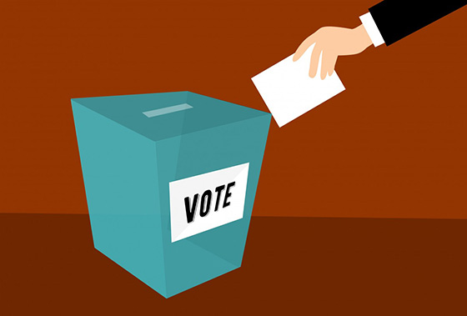
Elections are the main way that people can directly take part in democracy in Britain today?
In Britain we vote for people to represent us in Parliament in general elections.
The voters elect an MP (Member of Parliament) for each constituency (the country is divided into smaller geographical areas called constituencies. So, for example, Boris Johnson is the MP for the constituency of Uxbridge and South Ruislip which is an area of West London.)
An election is a process in which people vote to choose a person or group of people to hold an official position. In Britain we hold general elections which elect MPs to Parliament. We also have local and regional elections.
Our democracy depends on the state of our elections & election systems. This is why it is so important to see how our election system developed in the Nineteenth Century.
Notes:
We do also use referendums, such as the 2018 Brexit Referendum, but these are rarer events and are on just one single issue.

Slide 9
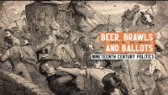
Researching 19th Century elections -The Victorian Election Violence Project
Researchers at the School of Government and International Affairs (SGIA) at Durham University have been investigating what happened during 19th Century elections.
Their research revealed that violence was a widespread and frequent occurrence during elections, often resulting in serious injuries, destruction of property, and sometimes even death.
Using newspaper reports and other sources the team have created a database of violent events during all general elections between 1832 and 1914.
This database, that can be accessed through an interactive map, provides a way to investigate the state of democracy and elections in the 19th Century.
Notes:
https://www.youtube.com/watch?v=HNe37hWfxsA This is the link to the video – it is just over 8 minutes long and explains the key findings from the research
The research was based on a detailed computer based search of all accounts of election violence found in local newspapers from the time (using the digitized archive held by the British Newspaper Archive). These accounts were then checked by human researchers and brought together on the interactive map that then forms the key tool for these lessons.

Slide 10
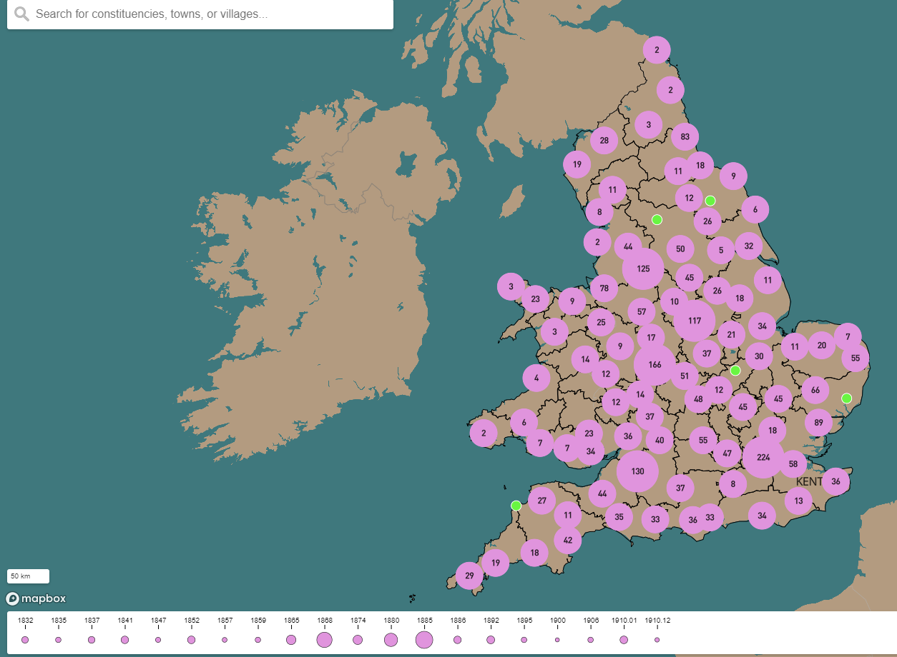
Interactive Map of Election Violence Events in England Wales, 1832 - 1914
http://victorianelectionviolence.uk/interactive-map/
The map displays English and Welsh election violence that occurred during the 20 General Elections between 1832 and 1914. It contains nearly 3,000 events, ranging from outright riots, involving multiple deaths, to minor incidents, such as the breaking of windows.
The map can be searched by place, date and the type of election violence.
Notes:
http://victorianelectionviolence.uk/interactive-map/
The above link provides access to the map and includes instructions on how to use it.

Slide 11
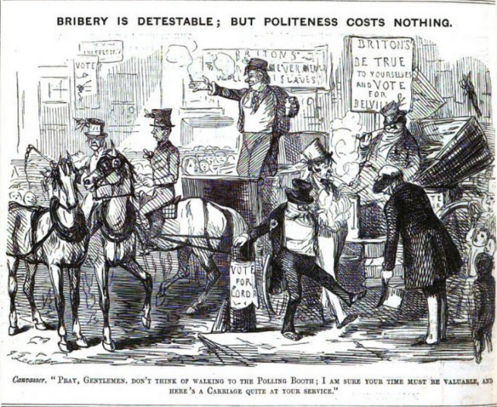
Bribery was a significant problem in Nineteenth Century Elections:
Bribery was widespread in earlier Nineteenth Century elections.
Some of the bribery was direct – with payments being made to voters in exchange for their vote.
A lot of the bribery was more indirect and was known as ‘treating’ at the time.
Treating could involve:
Providing free alcohol
Providing free entertainments for the crowds and voters, such as bands or boxing prize fights
Paying for meals & accommodation
Although bribery was illegal throughout the nineteenth century, it was largely tolerated and accepted as being part of elections.
What ‘treat’ is being offered in this cartoon from 1847?
Notes:
Punch 1847

Slide 12
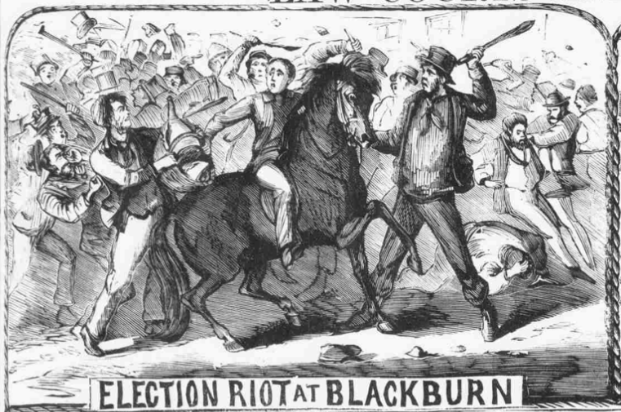
Intimidation and violence was a further problem in Nineteenth Century Elections:
‘Roughs’ were often hired by election candidates to intimidate both the voters and opposing candidates.
At the time ‘Roughs’ were also known as ‘Bullies’, ‘Bludgeon men’ and even ‘Lambs’.
In Ipswich, Suffolk, in 1859, the Conservative candidate hired a “notorious prize fighter”, or boxer. At first he was used to entertain and ‘treat’ the crowd, but then he was sent to stand at the “very entrance of the polling place”. This would have been a very intimidating sight for any Liberal voters.
During the 1868 election at Trowbridge, a group of ‘disreputable characters’ were hired by the Liberal party to cause disruption at polling, and intimidate the electors. This group was, of course, unenfranchised. What makes them all the more unusual, however, is that the group would not possess the vote even in the present day – they were hired thugs well under the age of 16!

Slide 13
Plenary: What have you discovered so far?
Elections are an important part of democracy because . . .
Bribery and the use of ‘roughs’ were problems for 19th century elections because . . . .

